Slide 1
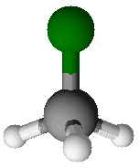
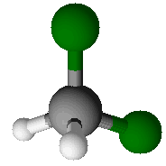
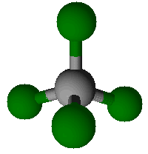
From P05 Marvelous Molecule, we saw that molecules with polar bonds tend to have higher boiling points.
The diagrams below show three molecules, all consisting of five atoms and having the same shape.
Fluoromethane
(CH₃F)
Difluoromethane
(CH₂F₂)
Tetrafluoromethane
(CF₄)
How would you rank the boiling points of the three molecules?

Slide 2
The boiling points of these three molecules are as shown below:
Fluoromethane
(CH₃F)
Boiling Point: -78.2 °C
Difluoromethane
(CH₂F₂)
Boiling Point: -51.6 °C
Tetrafluoromethane
(CF₄)
Boiling Point: -127.8 °C
We notice that a higher number of C-F bonds does not necessarily correspond with a higher boiling point.

Slide 3
Your challenge for the day!
Explain the relative boiling points of the three molecules when compared to one another.

